Slide 1


SMART INDIA HACKATHON 2025
Problem Statement ID - 26117
Problem Statement Title - Sovereign On-Premise Agentic AI Workbench using Open-Weight Multimodal LLMs for Confidential Industrial Work
Theme - Smart Automation
PS Category - software
Team ID -
Team Name - (Registered on portal)
1

Slide 2

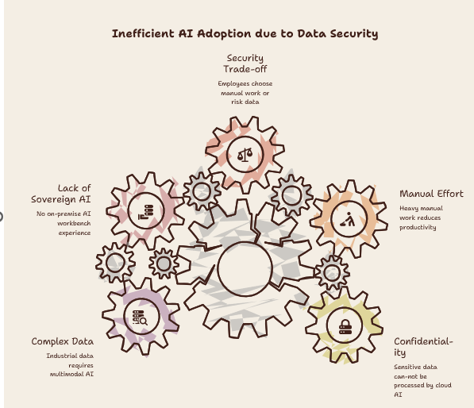
From Data-Security Risk to a Sovereign AI Advantage
THE PROBLEM
THE SOLUTION
Sovereign On-Premise AI Workbench for Confidential Industrial Work.
AI Workbench
Visible AI assistant
interface
Confidential
Sensitive information
Data
kept on premises
Open-Weight
Multiple models
LLMs
supported for task
selection
Agentic
Planning, tool execution,
Capabilities
and iteration
Multimodal
Processing text, images,
Understanding
and documents
Local
Grounding in
Knowledge
organization's internal
Base
data
100% On-Premise • Zero Data Leakage • Agentic & Multimodal

Slide 3







TECHNICAL APPROACH
System Architecture — Every Layer Stays Inside the Fence
USER WORKBENCH
AGENT ORCHESTRATOR
NO CLOUD API
NO EXTERNAL
DATA FLOW
Plan → Act → Verify
MODEL ROUTER
CORE STACK
REASONING
MODEL
CODING
MODEL
VISION
MODEL
Ollama / vLLM inference
Local vector DB (RAG)
LOCAL INFERENCE — Ollama / vLLM
OCR + open vision model
LOCAL RAG /
KNOWLEDGE BASE
LOCAL TOOLS +
SANDBOX
MULTIMODAL
PIPELINE
Sandboxed code exec
Network audit / zero-egress log
ARTIFACT ENGINE
DOCX · PPTX · XLSX · Code
AIR-GAPPED ORGANIZATION LAN (MRPL)
Audited · Zero external calls
3

Slide 4





FEASIBILITY & VIABILITY
Buildable Today, Scalable Tomorrow
Technical Feasibility
Deployment Feasibility
Open-weight models deployable locally today
MVP on a single workstation / server
Mature inference runtimes + local vector DBs
Scales to multi-GPU infrastructure
OCR/vision models run on modest GPUs
Fully air-gapped LAN deployment
Operational Feasibility
Scalability / Future
Role-based access control
Add new open-weight models, no re-architecture
Full audit logs of every agent action
Add new tools, formats, knowledge bases
Sandboxed, permission-scoped execution
Grows: workstation → server → cluster
MVP
→
PRODUCTION
→
ENTERPRISE
Local Workstation
On-Prem GPU Server
Air-Gapped Multi-User Deployment
4

Slide 6
RESEARCH AND REFERENCES
SIH26117 | Sovereign On-Premise Agentic AI Workbench | MRPL
Serve several local models at once
Open weights now match cloud-tier quality
Break tasks into plan-act-observe loops
Read scans and drawings without the cloud
Ground answers in local knowledge, fast
Foundational technique behind our RAG design
Confidential data must legally stay on-prem
Ollama / vLLM:
Local Multi-Model Serving
Qwen2.5 Family:
Open-Weight Reason, Code, Vision
LangGraph:
Agentic Planning & Tool Calls
PaddleOCR:
On-Device Scan & Handwriting Read
Qdrant:
Local Vector DB for RAG
Lewis et al., 2020:
Retrieval-Augmented Generation
DPDP Act, 2023:
India Data-Localisation Mandate
LINK
LINK
LINK
LINK
LINK
LINK
LINK
NETWORK AUDIT MONITOR
UI / UX
SOVEREIGN AI WORKBENCH
System secure
Outbound requests today: 0
“Draft an approval note from this scanned report.”
All model + tool calls served on-premise
Routed → Qwen2.5-14B + RAG
Plan: OCR scan → search SOP → draft → verify
Illustrative UI concept for the on-prem workbench console — not a live product screenshot

